Slide 1
JSP
Rajeev Gupta
M. Tech. CS

Slide 2
Goal
Simplification of creation and management of dynamic web sites

Slide 3
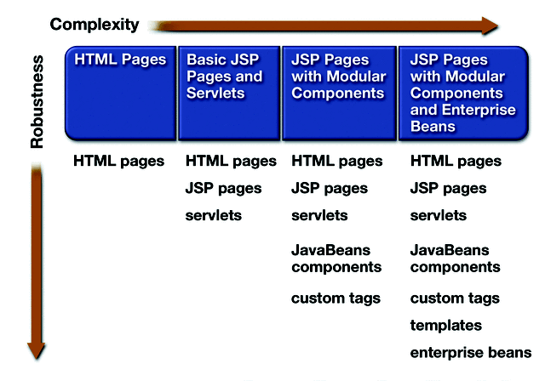
Web Application Designs
Notes:
This picture shows the evolution of web application starting from a simplest one which then evolves into more sophisticated and more robust design.
So in the first phase of the evolution, just static HTML pages were used to display static information. Then in the subsequent evolution phase, dynamic contents generation technologies such as CGI initially, then servlet and JSP are introduced to generate and display dynamic contents along with static contents.
When you are using JSP pages, you can use only the basic features that come with it. Or you can leverage more sophisticated features such as component-based dynamic contents generation, for example, leveraging JavaBeans or custom tags, which provide more reusable, more maintainable, more flexible development and deployment options.
Then in a more sophisticated environment, people use so-called template based design or eventually they might want to delegate their business logic processing to EJB tier.

Slide 4
How JSP works ?
First time JSP is loaded by JSP containers
Servlet code necessary to fulfill jsp tag automatically generated compiled and loaded into servlet container by JSP container
Compiled Servlet process any browser request for that JSP page
If modified Source code of JSP
It get automatically recompiled

Slide 5
JSP Page Lifecycle Phases
Translation phase
Compile phase
Execution phase
Notes:
So the lifecycle of a JSP page can be divided into three phases: (1) translation phase in which a JSP page gets translated into a servlet code, (2) compilation phase in which servlet code gets compiled, (3) then execution phase in which servlet instance then serves client request. Usually translation and compilation phases occur together.

Slide 6
JSP Life Cycle
 |  | Request #1 | Request #2 |  | Request #3 | Request #4 |  | Request #5 | Request #6
JSP page translated into servlet |  | Yes | No |  | No | No |  | Yes | No
JSP’s Servlet compiled |  | Yes | No |  | No | No |  | Yes | No
Servlet instantiated and loaded into server's memory |  | Yes | No |  | Yes | No |  | Yes | No
init (or equivalent) called |  | Yes | No |  | Yes | No |  | Yes | No
doGet (or equivalent) called |  | Yes | Yes |  | Yes | Yes |  | Yes | Yes
Page first written
Server restarted
Page modified

Slide 7
JSP Lifecycle Methods during Execution Phase
Notes:
Once the page has been translated and compiled, the JSP page's servlet for the most part follows the servlet life cycle as following:
1. If an instance of the JSP page's servlet does not exist, the container Loads the JSP page's servlet class
2. Container then creates an instance of the servlet class
3. Container then initializes the servlet instance by calling the jspInit method
4. Container invokes the _jspService() method, passing a request and response object.
If the container needs to remove the JSP page's servlet, it calls the jspDestroy() method.

Slide 8
Model 1 Architecture
EJB
Java Bean
Browser
JSP
Database
Custom
Tags

Slide 9
Model 2 Architecture
2
Servlet
EJB
3
Browser
1
4
Java Bean
Database
5
JSP
6
Custom
Tags

Slide 10
JSP tags
HTML code: <html-tag>content</html-tag>
JSP Comments: <%-- comment --%>
Expressions: <%= expression %>
Scriptlets (statements): <% code %>
Declarations: <%! code %>
Directives: <%@ directive attribute="value" %>
Actions: <jsp:forward.../>, <jsp:include.../>
Expression-Language Expressions: ${expression}

Slide 11
JSP tags
JSP tags are classified as:-
Directive:
Affect overall structure of Servlet that result from translation.
Scripting Elements:
Allows inserting Java code into JSP pages
Action:
Affect Runtime behavior of JSP

Slide 12
JSP Directive

Slide 13
JSP Directive
Used to set global values such as class declaration, methods, O/P content type
Page directive have scope for entire page
<%@ ………….%>
3 type of JSP Directive are:-
Page directive
Include directive
Taglib directive

Slide 14
page-Directive
import attribute: A comma separated list of classes/packages to import
<%@ page import="java.util.*, java.io.*" %>
contentType attribute: Sets the MIME-Type of the resulting document (default is text/html)
<%@ page contentType="text/plain" %>
session="true|false" specifies if to use a session?
buffer="sizekb|none|8kb"
Specifies the content-buffer (out) size in kilo-bytes
autoFlush="true|false"
Specifies whether the buffer should be flushed when it fills, or throw an exception otherwise
isELIgnored ="true|false"
Specifies whether JSP expression language is used

Slide 15
Page Directive Example…
<%@ page language=“java” import=“java.util.Date(), java.util.Dateformate()” iserrorpage=“false”%>

Slide 16
Include directive
Instruct container to include content of resources in current JSP (inserting inline)
Ex: consider a.jsp contains
<%@ include file=“abc.jsp”> →
All code of abc.jsp is copied to a.jsp
As of Tomcat 5.x, generated Servlets are updated when included files change (unlike older versions...)

Slide 17
Include Directive
File1.jsp
File2.jsp
HTML
content
Servlet

Slide 18
Include directive :Example
Demo.jps
<html>
<head></head>
<body>
<h1>include directive</h1>
<%@ include file=“include.jsp”%>
</body>
<body>
</html>
include.jsp
<%page import=“java.util.Date”%>
<%=“Current date is”+new Date()%>

Slide 19
Error Pages
We can set one JSP page to be the handler of uncaught exceptions of another JSP page, using JSP directives
<%@ page errorPage="url " %>
Defines a JSP page that handles uncaught exceptions
The page in url should have true in the page-directive:
<%@ page isErrorPage="true|false" %>
The variable exception holds the exception thrown by the calling JSP

Slide 20
Error page Example
<html>
<head><title>Reading From Database </title></head>
<body>
<%@ page import="java.sql.*" %>
<%@ page errorPage="errorPage.jsp" %>
<%
Class.forName(“com.mysql.jdbc.Driver");
Connection con = DriverManager.getConnection(“…..”);
%>
<h2>Can Connect!!</h2>
</body>
</html>

Slide 21
<html>
<head><title>Connection Error</title></head>
<body>
<%@ page import="java.io.*" %>
<%@ page isErrorPage="true" %>
<h1>Oops. There was an error when you accessed the
database.</h1>
<h2>Here is the stack trace:</h2>
<pre style="color:red">
<% exception.printStackTrace(new PrintWriter(out)); %>
</pre>
</body>
</html>

Slide 22
Scripting Elements

Slide 23
Declaration
Block of Java code in JSP that used to define class wide variable and methods in generated servlet..
Ex:
<%! Int numtimes=3;
public String sayHello(String name)
{
return (“Hello”+name);
}
<html>
<head>Declaration test</head>
<body>
<p>The value of num time is <%=numtime %><?p>
<p>Hello to :<%=sayHello(“foo and bar…”)%></p>
</body>
</html>

Slide 24
Decleration Ex: counter
<%! private int accessCount = 0; %>
<%! private synchronized int incAccess() {
return ++accessCount;
} %>
<h1>Accesses to page since Servlet init:
<%= incAccess() %> </h1>

Slide 25
Scriptlets
Block of Java code that is executed during request processing time <%...%>
All code b/w <%...%> tags in JSP gets put into service() method
EX:
<%
String un=request.getParameter(“un”);
%>
<input type=“text” value=“<%=un%>”>
….
…..

Slide 26
Example: Scriptlet.jsp
Scriptlet.jsp
<html>
<head><title>hi it is scriptlet test </title></head>
<%
for(int i=0;i<10;i++)
{
out.println(“Scriptlet test”+i+”<br>”);
System.out.println(“Goes to Console of server”);
}
%>
</body>
</html>

Slide 27
Example: login.jsp
<%
if((request.getParameter(“un”).equals(“raj”)) &&(request.getParameter(“pw”).equals(“java”)))
{
%>
<jsp:forward page=“forward2.jsp”/>
<%
}
else
{
%>
<%@include file=“index.jsp”%>
<%
}
%>

Slide 28
Scriptlet Misuse
<%@page language=“java” import=“java.sql.*”%>
<% String name=request.getParameter(“name”);
String pass=request.getParameter(“pw”);
try
{
Class.forName(“sun.jdbc.odbc.JdbcOdbcDriver”);
connection con=null;
con=DriverManager.getConnection(“jdbc:odbc:rajconn”,”root”,”root”);
PreparedStatement st=con.prepareStatement(“select * from pass where username=? And password=?”);
st.setString(1,un);
st.setString(2,pw);
ResultSet rs=st.executeQuery();
if(rs.next())
{
%>
<jsp:forward page=“forward2.jsp”/>
<%
}
else
{
out.println(“Invalid un and password”);
%>
<%@include file=“index.jsp”%>
<%
}
catch(Exception e)
{
out.println(e.getMessage());
%>

Slide 29
Expression
<%= and %>
Short cut notation for script let that sends value off a java expression to the client
Expression.jsp
<html>
<head><title>hi it is expression test </title></head>
<%! int i=0;%>
<%i++; %>
<%=“This jsp is accessed “+i+” times”%>
</body>
</html>

Slide 30
Predefined Variables (Implicit Objects)
The following predefined variables can be used:
request: the HttpServletRequest
response: the HttpServletResponse
session: the HttpSession associated with the request
out: the PrintWriter (a buffered version of type JspWriter) used to fill the response content
application: The ServletContext
config: The ServletConfig

Slide 31
<html>
<head>
<title>JSP Expressions</title>
</head>
<body>
<li>Current time: <%= new java.util.Date() %></li>
<li>Your hostname:<%= request.getRemoteHost() %></li>
<li>Your session ID: <%= session.getId() %></li>
<li>The <code>testParam</code> form parameter:
<%= request.getParameter("testParam") %></li>
</body>
</html>

Slide 32
Understanding Scopes

Slide 33
Different Object Scopes
Most visible
page
Objects may be accessed only within pages
where they are created
Least visible

Slide 34
Different Object Scopes
Most visible
request
Only within pages processing the request
in which they are created
page
Objects may be accessed only within pages
where they are created
Least visible

Slide 35
Different Object Scopes
Most visible
session
Only from pages belonging to same session
as the one in which they were created
request
Only within pages processing the request
in which they are created
page
Objects may be accessed only within pages
where they are created
Least visible

Slide 36
Different Object Scopes
Most visible
application
Within all pages belonging to same
application
session
Only from pages belonging to same session
as the one in which they were created
request
Only within pages processing the request
in which they are created
page
Objects may be accessed only within pages
where they are created
Least visible

Slide 37
Object Scopes session, request & page

Slide 38
Object Scopes session vs. application

Slide 39
Standard Actions JSP beans

Slide 40
Standard Actions
Tags that affect runtime behavior of JSP and response send back to client
Std action types:
<jsp:useBean>
<jsp:setProperty>
<jsp:getProperty>
<jsp:param>
<jsp:include>
<jsp:forward>
<jsp:plugin>

Slide 41
<jsp:useBean>
To separate code from presentation …
Encapsulate code in a
JavaBean (POJO) and then instantiate and use this object within our jsp
<jsp:useBean> used to create instance of JavaBean and assign to a variable name(or id)
<jsp:useBean id=“ob” scope=“scopename” class=“Emp”/>
Scope: request. session.,application or page
<jsp:setProperty property=“name” name=“ob” value=“raj”/>
<jsp:getProperty property=“name” name=“ob”/>

Slide 42
Small Examples on JavaBean
<form action="MyJspController.jsp">
Name: <input type="text" name="name"/>
Pass: <input type="password" name="pass"/>
<input type="submit"/>
</form>

Slide 43
User.java i.e. bean
package com;
import java.io.Serializable;
public class User implements Serializable{
private String name;
private String pass;
public String getName() {
return name;
}
public void setName(String name) {
this.name = name;
}
public String getPass() {
return pass;
}
public void setPass(String pass) {
this.pass = pass;
}
public boolean isValid(){
if(this.getName().equalsIgnoreCase("raj")&&this.getPass().equalsIgnoreCase("raj"))
return true;
else
return false;
}
}

Slide 44
Bean.jsp
<jsp:useBean id="ob" class="com.User" scope="page">
<jsp:setProperty property="name" name="ob"/>
<jsp:setProperty property="pass" name="ob" />
</jsp:useBean>
<jsp:getProperty property="name" name="ob"/>
<jsp:getProperty property="pass" name="ob"/>
<%= ob.isValid() %>

Slide 45
<jsp:include> and <jsp:forward>
This action allows a static/dynamic resources specified by URL to be included in current JSP at processing time
An included page has only access to JspWriter object
Equivalent to javax.servlet.RequestDispatcher include()method..
If page O/P is buffered then buffered is flushed prior to inclusion
<jsp: include page=“my.jsp” flush=“true”>
Include page my.jsp and buffer is flushed
Note:
Use include directive : if resource is not changing frequently
Use include action: if resource is changing frequently

Slide 46
Include - Action
Using RequestDispatcher
File1.jsp
HTML
content
Servlet1
HTML
content
Main JSP
File2.jsp
Servlet2
HTML
content

Slide 47
Forward.jsp
<%
if((request.getParameter(“un”).equals(“raj”)) &&(request.getParameter(“pw”).equals(“java”)))
{
%>
<jsp:forward page=“forward2.jsp”/>
<%
}
else
{
%>
<%@include file=“index.jsp”%>
<%
}
%>

Slide 48
Forward2.jsp
<html>
<head><title>usebean action test page</title></head>
<body>
<h1> forward action test: login sucessful</h1>
<p>welcome<%=request.getParameter(“un”)%>
</body>
</html>

Slide 49
Using <jsp:param> to pass parameter while doing RequestDispaching…
html>
<head>
<title>Include (action) Example</title>
</head>
<body>
<h2>Included part begins:<h2><hr/>
<jsp:include page="/requestParams2.jsp" >
<jsp:param name="sessionID" value="<%= session.getId() %>" />
</jsp:include>
<hr/><h2>Included part ends<h2>
</body>
</html>

Slide 50
requestParams2.jsp
------------------------------
<%@ page import="java.util.*" %>
<%
Enumeration parameterNames = request.getParameterNames();
while (parameterNames.hasMoreElements())
{
String name = (String)parameterNames.nextElement();
out.println(name);
out.println(request.getParameter(name) );
}
%>

Slide 51
initialize servlet via JSP
<web-app ...>
<servlet>
<servlet-name>myTestJSPInit</servlet-name>
<jsp-file>/TestInit.jsp</jsp-file>
<init-param>
<param-name>email</param-name>
<param-value>rgupta.mtech@gmail.com</param-value>
</init-param>
</servlet>
<servlet-mapping>
<servlet-name>myTestJSPInit</servlet-name>
<url-pattern>/TestInit.jsp</url-pattern>
</servlet-mapping>
</web-app>

Slide 52
ways to get the web.xml init parameter
<%-- override the jspInit() method %>
<%!
public void jspInit() {
ServletConfig sConfig = getServletConfig();
String emailAddr = sConfig.getInitParameter("email");
ServletContext ctx = getServletContext();
ctx.setAttribute("mail", emailAddr);
}
%>

Slide 53
Getting things in body
<%= "Mail Attribute is: " + application.getAttribute("mail") %>
<br>
<%= "Mail Attribute is: " + pageContext.findAttribute("mail") %>
<%
ServletConfig sConfig = getServletConfig();
String emailAddr = sConfig.getInitParameter("email");
out.println("<br><br>Another way to get web.xml attributes: " + emailAddr );
%>
<%
out.println(getServletConfig ().getInitParameter("email") );
%>

Slide 54
Using <jsp:useBean ....>
Servlet code:
------------------------------------------------------------------
----
foo.Person p = new foo.Person();
p.setName("Paul");
request.setAttribute("person", p);
RequestDispatcher view = request.getRequestDispatcher("result.jsp");
view.forward(request, response);
....
Retriving in JSP
-----------------------------------
<html><body>
Person is: <%= request.getAttribute("person") %>
</body></html>
Correct way
-------------------------------------------
<% foo.Person p = (foo.Person) request.getAttribute("person");%>
Person is: <%= p.getName() %>

Slide 55
Better way
<jsp:useBean id="person" class="foo.Person" scope="request" />
Person is: <jsp:getProperty name="person" property="name" />

Slide 56
What if we wanted the reference type to be different from the actual object type
in other words the Person class is an abstract class and make a concrete subclass called Employee
Person
|
Employee
-----------------------------------------------
<jsp:useBean id="person" type="foo.Person" class="foo.Employee" scope="page">
----------------------------------------------------------------

Slide 57
Expression Language

Slide 58
What is EL
EL (Expression Language), it is now part of the JSP 2.0 spec.
EL offers a simpler way to invoke Java code
EL example
-------------------
# Java Expression (old way don't do now) Please contact: <%= application.getAttribute("mail") %> # EL way please contact: ${applicationScope.mail}

Slide 59
Stoping all JSP pages from using any scripting elements
<web-app ...> ... <jsp-config> <jsp-property-group> <url-pattern>*.jsp</url-pattern> <scripting-invalid>true</scripting-invalid> <el-ignored>true</el-ignored> </jsp-property-group> </jsp-config> ... </web-app>
stop using EL
----------------
<%@ page isELIgnored="true" %> Note: this takes priority over the DD tag above

Slide 60
How EL make life Easy
Consider this code in controller servlet
-------------------------------------------------------------
foo.Person p = new foo.Person(); p.setName("Paul"); foo.Dog dog = new foo.Dog(); dog.setName("Spike"); p.setDog(dog); request.setAttribute("person", p);
using tags
---------------
<%= ((foo.Person) request.getAttribute("person")).getDog().getName() %>
JSP Code using EL
----------------------------
<html><body> Dog's name is: ${person.dog.name}
</body></html>

Slide 61
Servlet code
----------------
String[] footballTeams = { "Liverpool", "Manchester Utd", "Arsenal", "Chelsea" } request.setAttribute("footballList", footballTeams);
JSP Code
--------------
Favorite Team: ${footballList[0]} Worst Team: ${footballList["1"]} <%-- using the arraylist toString() All the teams: ${footballList}
Note: The index value in the brackets is a String literal
which means it gets coerced into an int, which means ["one"] would not work but ["10"] would.

Slide 62
Servlet code
-----------------------
java.util.Map foodMap = new java.util.HashMap(); foodMap.put("Fruit", "Banana"); foodMap.put("TakeAway", "Indian"); foodMap.put("Drink", "Larger"); foodMap.put("Dessert", "IceCream"); foodMap.put("HotDrink", "Coffee"); String[] foodTypes = {"Fruit", "TakeAway", "Drink", "Dessert", "HotDrink"} request.setAttribute("foodMap", foodMap);
JSP Code
------------
Favorite Hot Drink is: ${foodMap.HotDrink} Favorite Take-Away is: ${foodMap["TakeAway"]} Favorite Dessert is: ${foodMap[foodTypes[3]]}

Slide 63
Using paramValues
Use paramValues when you want multiple values for one given parameter name
Example
----------
HTML Form
<html><body> <form action="TestBean.jsp"> name: <input type="text" name="name"> ID: <input type="text" name"empID"> First food: <input type="text" name="food"> Second food: <input type="text" name="food"> <input type="submit"> </form> </body></html>

Slide 64
JSP Code
--------------
Request param name is: ${param.name} <br> Request param empID is: ${param.empID} <br> <%-- you will only get the first value --> Request param food is: ${param.food} <br> First food is: ${paramValues.food[0]} <br> Second food is: ${paramValues.food[1]} <br>

Slide 65
Getting other parameters with EL
host header
Host is: <%= request.getHeader("host) %> Host is: ${header["host"]} Host is: $header.host}
Request method (Post or Get)
Method is: ${pageContext.request.method}
Cookie information
Username is: ${cookie.userName.value}
Context init parameter
email is: <%= application.getInitParameter("mainEmail") %> email is: {$initParam.mainEmail} note: you need to configure the parameter in the DD

Slide 66
Quick recap…
Element Type | Example
directive | <%@ page import="java.util.*" %>
declaration | <%! int y = 3; %>
EL Expression | email: ${applicationScope.mail}
scriptlet | <% Float one = new Float(42.5); %>
expression | <%= pageContext.getAttribute(foo") %>
action | <jsp:include page="foo.html" />

Slide 67
Using JSTL

Slide 68
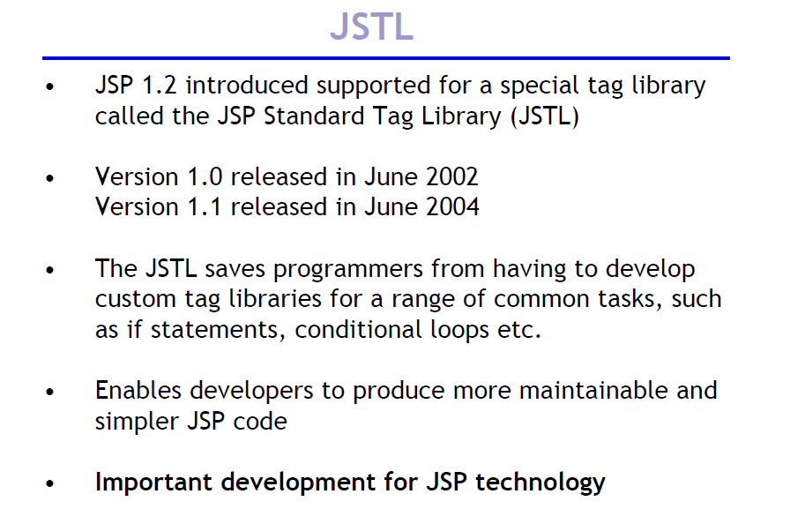

Slide 69
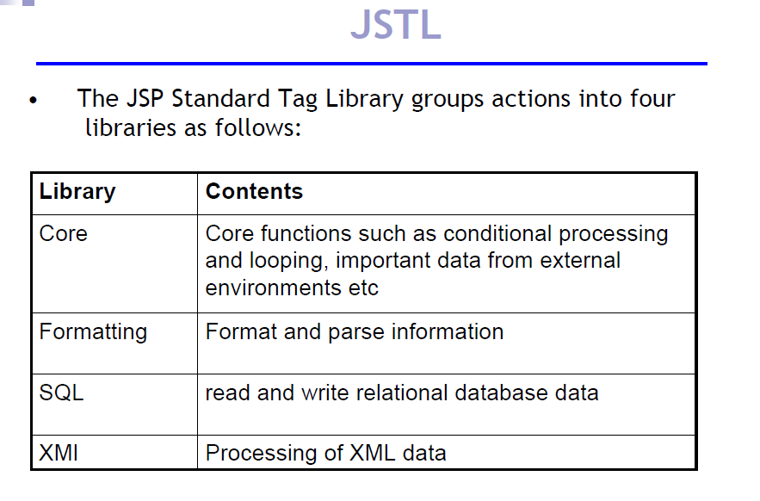

Slide 70
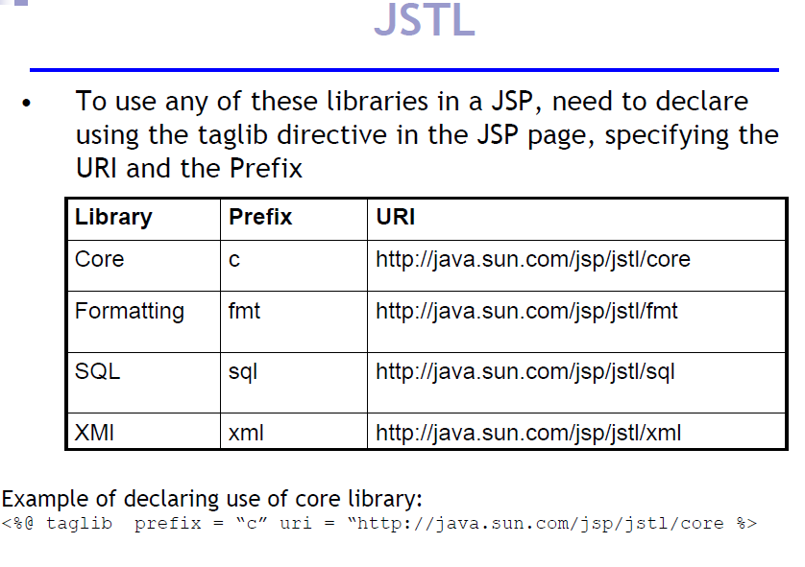

Slide 71
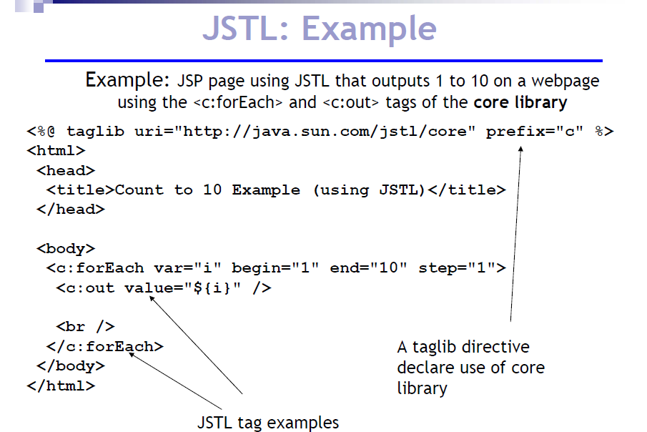

Slide 72
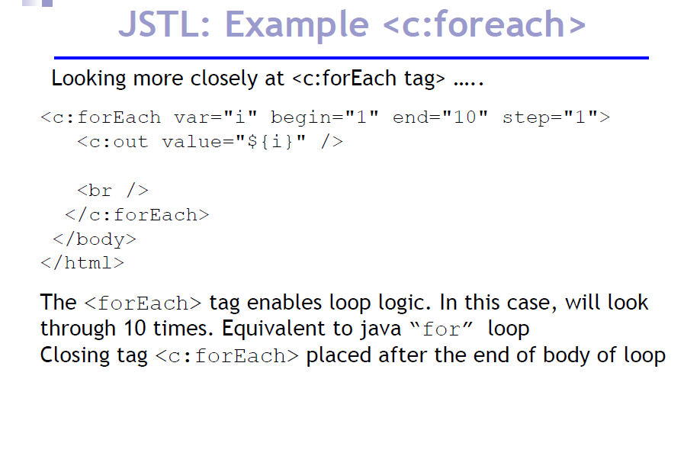

Slide 73
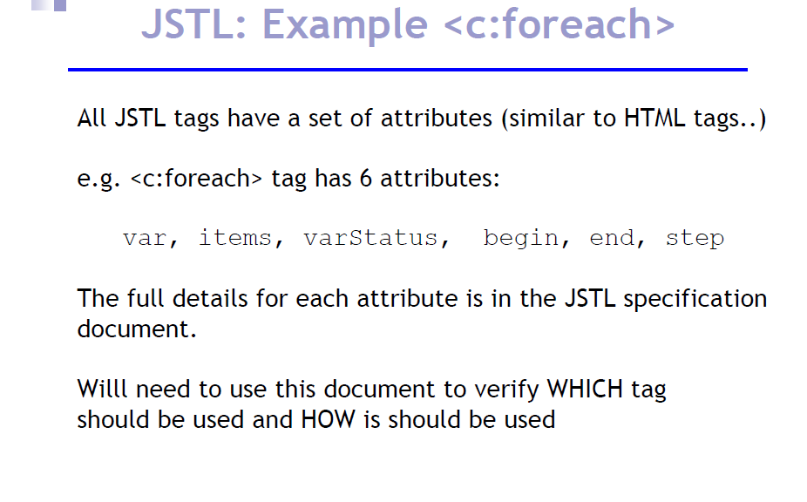

Slide 74
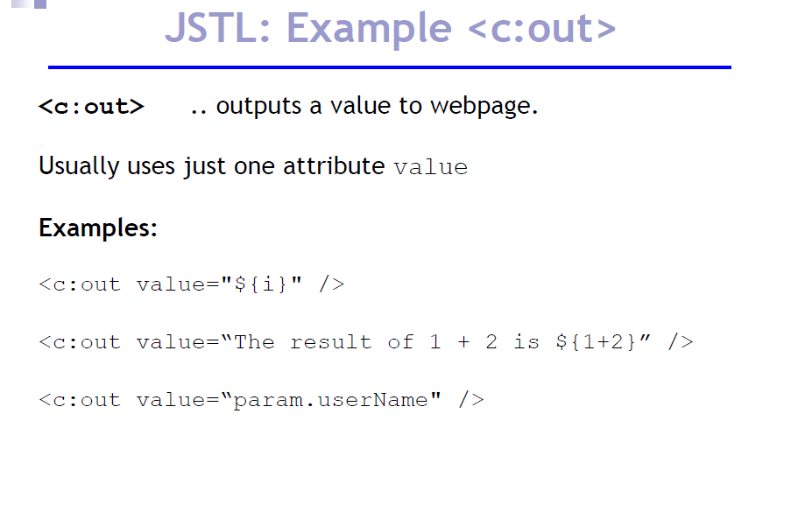

Slide 75
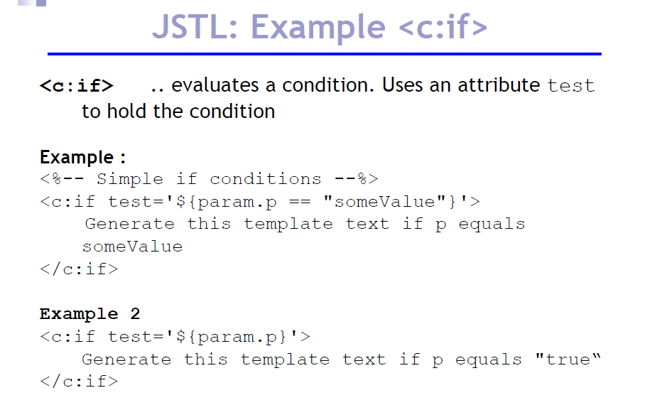

Slide 76
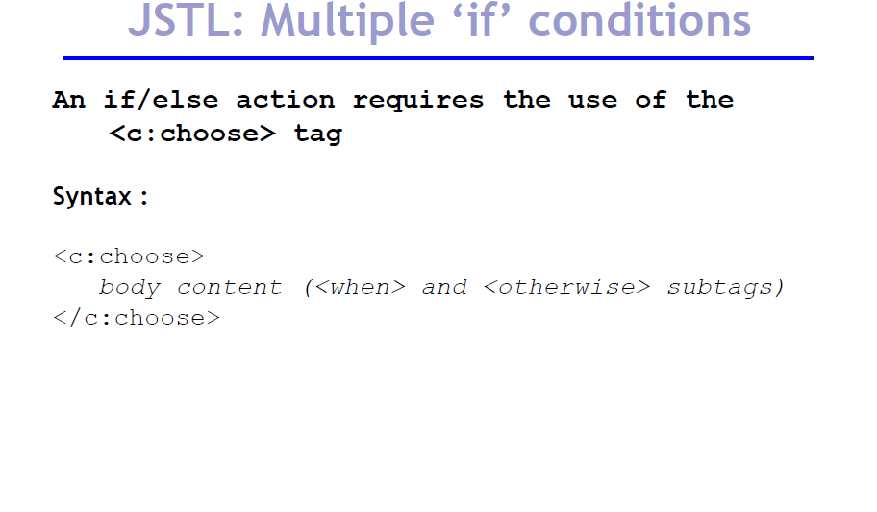

Slide 77
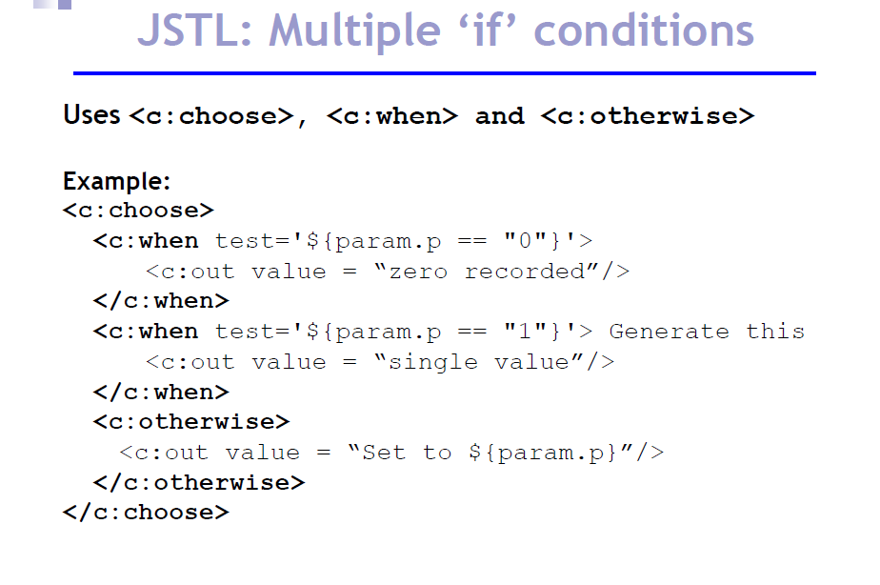

Slide 78
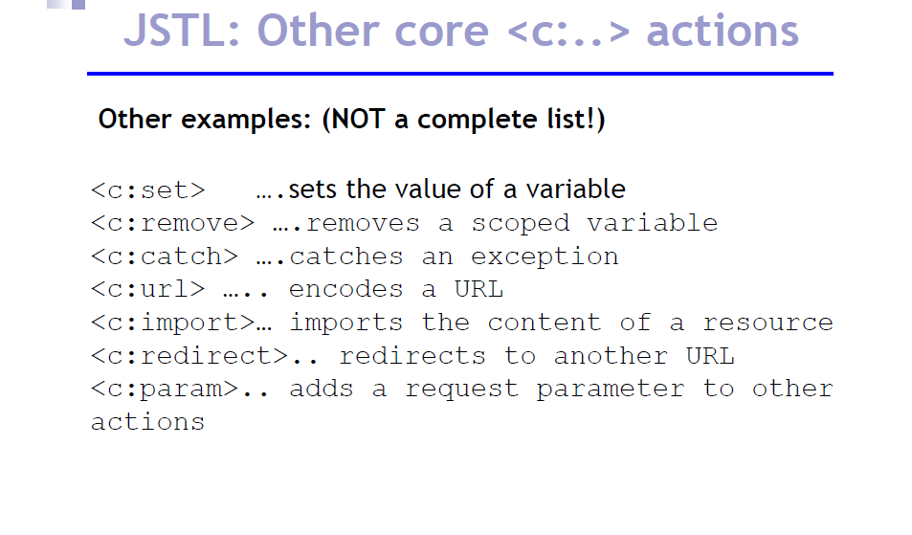

Slide 79
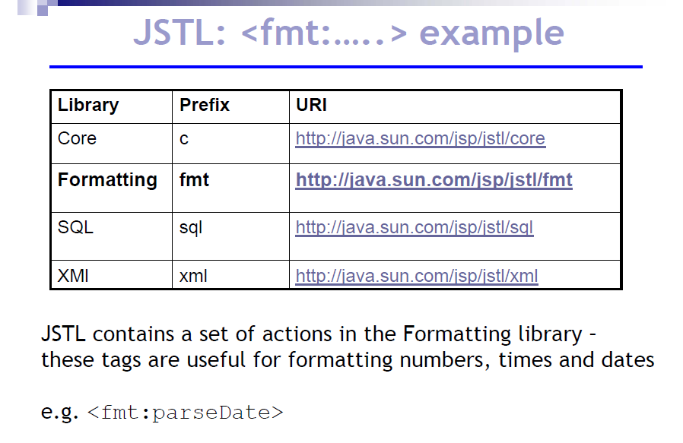

Slide 80
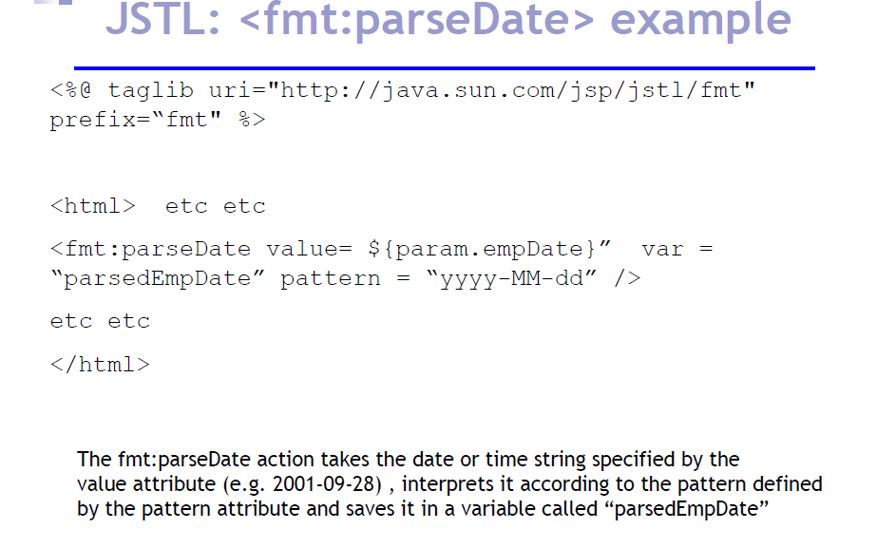

Slide 81
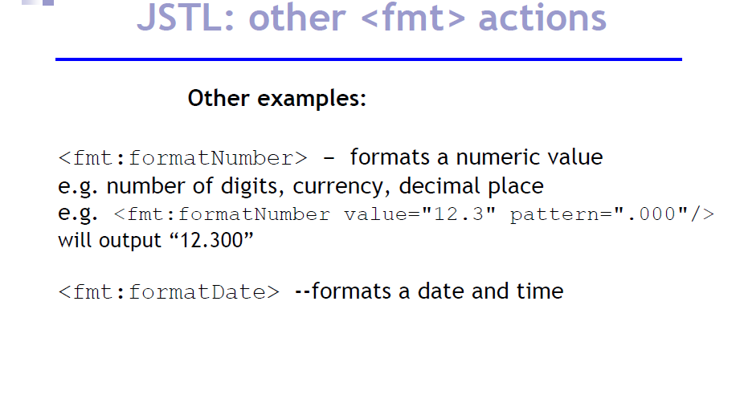

Slide 82
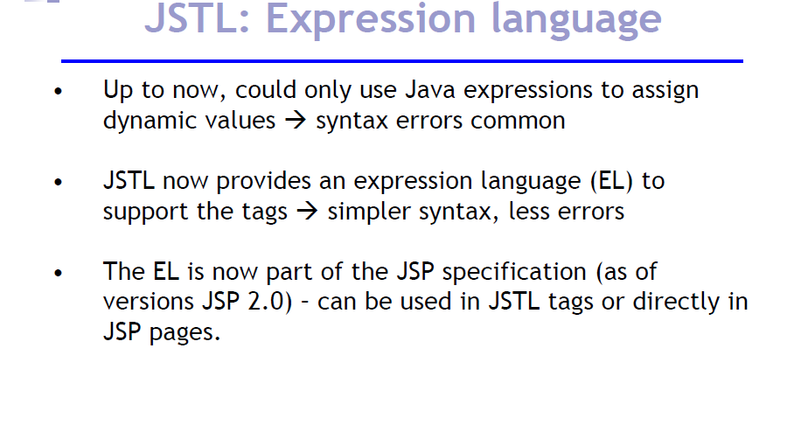

Slide 83
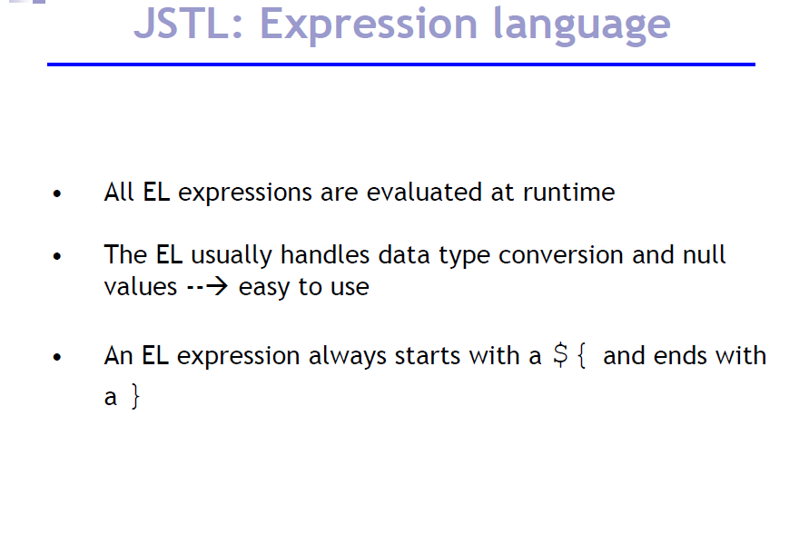

Slide 84
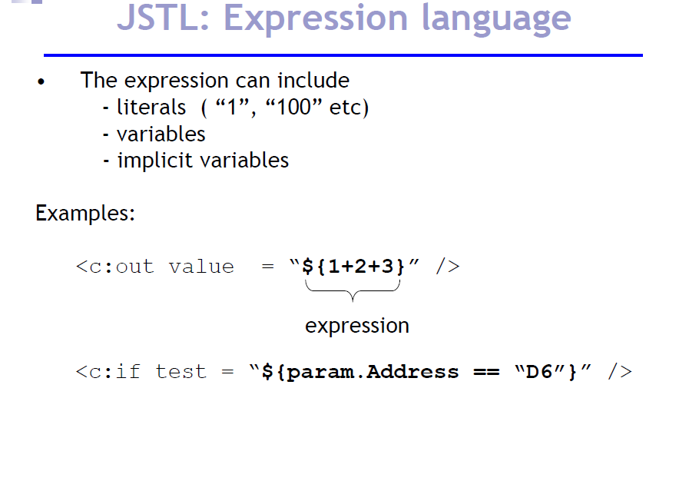

Slide 85
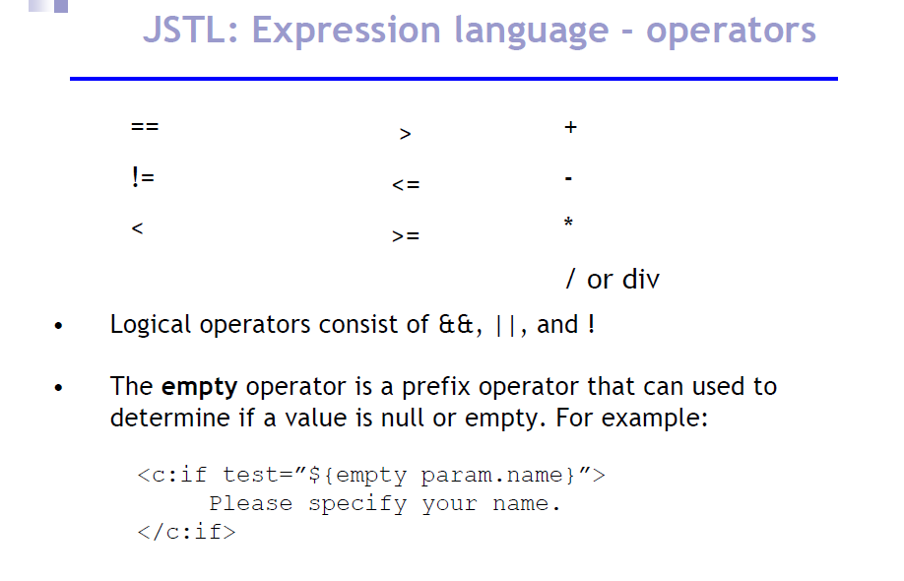

Slide 86
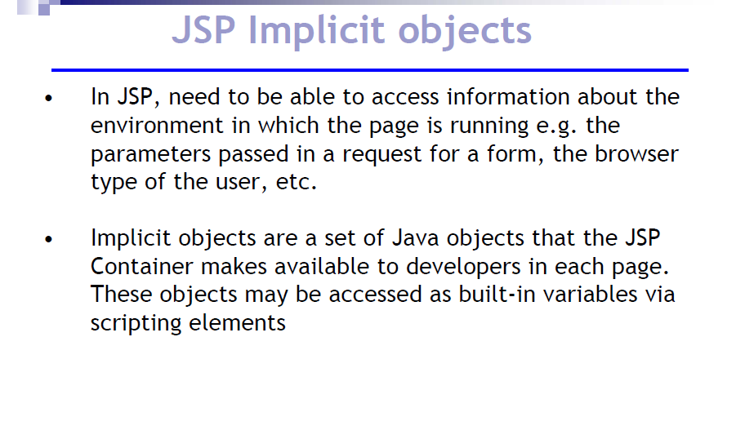

Slide 87
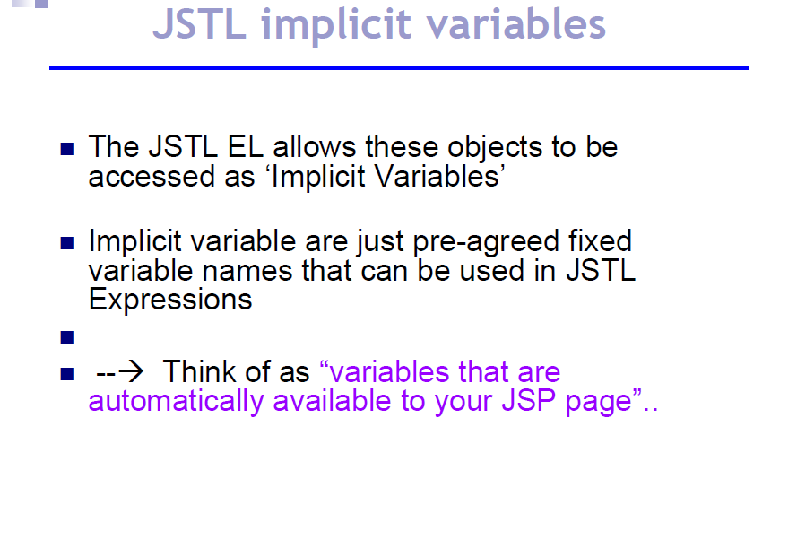

Slide 88
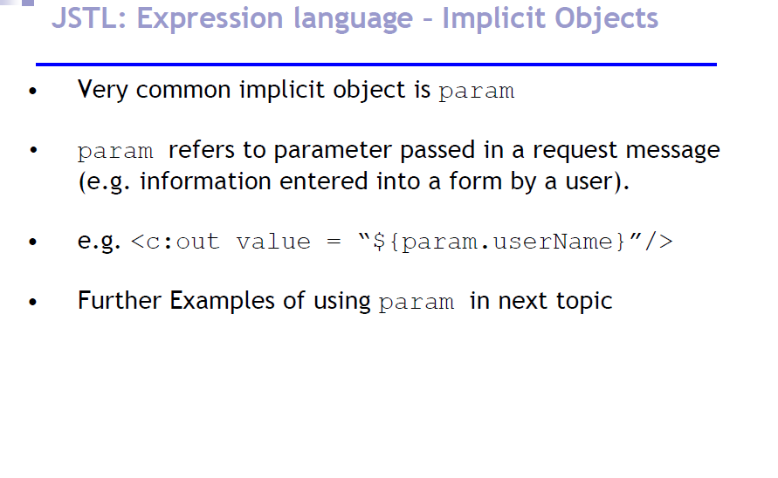

Slide 89

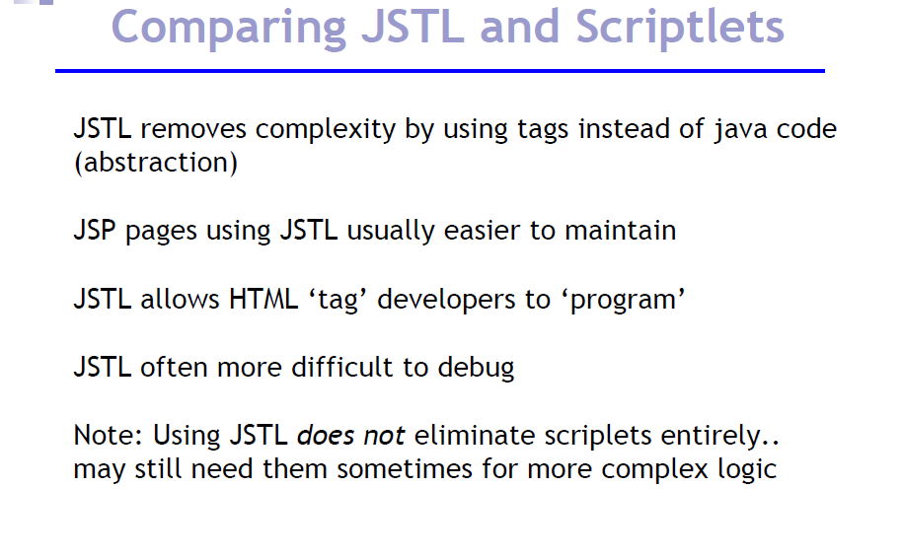

Slide 90
Loan Calculator application

Slide 91
Example Loan Calculator
Gets input to compute loan from user →
index.jsp
Header.jsp
Footer.jsp
Selects the right jsp for calculating loan →
controller.jsp
Computes loan based on simple interest
simple.jsp
Header.jsp
Footer.jsp
compound.jsp
Computes loan based on simple interest
error.jsp
Calculate loan
error.jsp
Calculate loan
Handles error if exception is thrown
Handles error if exception is thrown
Notes:
Potential Damages:
1. Change orders placed by the client (Instead of 500 widgets he can make the order 50,000 widgets)
2. Change meeting venues to send people on wild goose chases

Slide 92
Loan Calculator index.jsp
<html>
<head>
<title>Include</title>
</head>
<body style="font-family:verdana;font-size:10pt;">
<%@ include file="header.html" %>
<form action="controller.jsp">
<table border="0" style="font-family:verdana;font-size:10pt;">
<tr>
<td>Amount:</td>
<td><input type="text" name="amount" />
</tr>
<tr>
<td>Interest in %:</td>
<td><input type="text" name="interest"/></td>
</tr>
<tr>
<td>Compound:</td>
<td><input type="radio" name="type" value="C" checked/></td>
</tr>
<tr>
<td>Simple:</td>
<td><input type="radio" name="type" value="S" /></td>
</tr>
<tr>
<td>Period:</td>
<td><input type="text" name="period"/></td>
</tr>
</table>
<input type="submit" value="Calculate"/>
</form>
<jsp:include page="footer.jsp"/>
</body>
</html>
Notes:
Potential Damages:
1. Change orders placed by the client (Instead of 500 widgets he can make the order 50,000 widgets)
2. Change meeting venues to send people on wild goose chases

Slide 93
Loan Calculator Miscelaneous
controller.jsp
<%
String type = request.getParameter("type");
if(type.equals("S")) {
%>
<jsp:forward page="/simple.jsp"/>
<%
} else {
%>
<jsp:forward page="/compound.jsp"/>
<%
}
%>
error.jsp
<%@ page isErrorPage="true" %>
<html>
<head>
<title>Simple</title>
</head>
<body style="font-family:verdana;font-size:10pt;">
<%@ include file="header.html" %>
<p style="color=#FF0000"><b><%= exception.getMessage() %></b></p>
<jsp:include page="footer.jsp"/>
</body>
</html>
header.jsp
<h3>Loan Calculator</h3>
footer.jsp
<%= new java.util.Date() %>
Notes:
Potential Damages:
1. Change orders placed by the client (Instead of 500 widgets he can make the order 50,000 widgets)
2. Change meeting venues to send people on wild goose chases

Slide 94
Loan Calculator simple.jsp
<%@ page errorPage="error.jsp" %>
<%!
public double calculate(double amount, double interest, int period) {
if(amount <= 0) {
throw new IllegalArgumentException("Amount should be greater than 0: " + amount);
}
if(interest <= 0) {
throw new IllegalArgumentException("Interest should be greater than 0: " + interest);
}
if(period <= 0) {
throw new IllegalArgumentException("Period should be greater than 0: " + period);
}
return amount*(1 + period*interest/100);
}
%>
<html>
<head>
<title>Simple</title>
</head>
<body style="font-family:verdana;font-size:10pt;">
<%@ include file="header.html" %>
<%
double amount = Double.parseDouble(request.getParameter("amount"));
double interest = Double.parseDouble(request.getParameter("interest"));
int period = Integer.parseInt(request.getParameter("period"));
%>
<b>Pincipal using simple interest:</b>
<%= calculate(amount, interest, period) %>
<br/><br/>
<jsp:include page="footer.jsp"/>
</body>
</html>
Notes:
Potential Damages:
1. Change orders placed by the client (Instead of 500 widgets he can make the order 50,000 widgets)
2. Change meeting venues to send people on wild goose chases

Slide 95
Loan Calculator compound.jsp
<%@ page errorPage="error.jsp" %>
<%!
public double calculate(double amount, double interest, int period) {
if(amount <= 0) {
throw new IllegalArgumentException("Amount should be greater than 0: " + amount);
}
if(interest <= 0) {
throw new IllegalArgumentException("Interest should be greater than 0: " + interest);
}
if(period <= 0) {
throw new IllegalArgumentException("Period should be greater than 0: " + period);
}
return amount*Math.pow(1 + interest/100, period);
}
%>
<html>
<head>
<title>Compound</title>
</head>
<body style="font-family:verdana;font-size:10pt;">
<%@ include file="header.html" %>
<%
double amount = Double.parseDouble(request.getParameter("amount"));
double interest = Double.parseDouble(request.getParameter("interest"));
int period = Integer.parseInt(request.getParameter("period"));
%>
<b>Pincipal using compound interest:</b>
<%= calculate(amount, interest, period) %>
<br/><br/>
<jsp:include page="footer.jsp"/>
</body>
</html>
Notes:
Potential Damages:
1. Change orders placed by the client (Instead of 500 widgets he can make the order 50,000 widgets)
2. Change meeting venues to send people on wild goose chases

